Slide 1
Programming with Spelling Suggestions
Notes:
This is the pyret version of this lesson. Make sure you are using the right software tool (WeScheme, Pyret, CODAP, etc...)
To learn more about how to use PearDeck, and how to view the embedded links on these slides without going into present mode visit https://help.peardeck.com/en

Slide 2
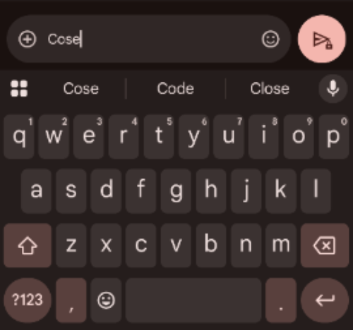
Introducing Contracts
Make sure you've got the Spell Checker Starter File open, and your Definitions Area includes
results = alt-words("plation", WORDS-L, 4).
Our spell-checker gives us lots of data to play with, in the form of tables of suggested words and their edit distances. We know how to save that data using variable definitions, so that we can refer back to it without having to recalculate the whole table.
Can we do anything interesting with that data?

Slide 3

Introducing Contracts
A spell-checker doesn't give us a table of 500 suggestions. Our cell phones don't tell us the edit distance for the suggestions they make. But just because it doesn't show us the edit distance doesn't mean it's not used! Your cell phone and spell checker uses the edit distance to help pick out the most-likely words to suggestion.
We want to take the output of alt-words and do something to it, just as spell checkers and cell phones do.

Slide 4
Introducing Contracts
Turn to Sorting and Trimming Tables and complete the first section: Sorting Results.

Slide 5
Introducing Contracts
What did these sort expressions do?
What does it mean that the Range of sort is Table?
Type results and hit "Enter". Did sorting our animals change the value of the table?
Notes:
What did these sort expressions do?
They took in the results table, the edit-distance column, and true or false... producing a new table, sorted alphabetically (ascending for true and descending for false)
What does it mean that the Range of sort is Table?
The function produces a new table.
Type results and hit "Enter". Did sorting our animals change the value of the table?
No. It made a new one.

Slide 6
Introducing Contracts
Let's review what we've learned about Contracts. Every Contract has three parts:
Name -- the name of the function, which we type in whenever we want to use it
Domain -- the type(s) of data we give to the function
Range -- the type of data the function produces
📌 Contracts are the instruction manual for functions.

Slide 7
Introducing Contracts
Let's explore the Contract for another function that works with Tables: first-n-rows
Complete the second section of Sorting and Trimming Tables: Trimming Results.

Slide 8
Introducing Contracts
Pyret knows about more than just Numbers, String, Booleans, and Tables! It can also make Images.
Have some fun with Contracts for Image-Producing Functions.
Notes:
Supporting Diverse Learners
Image exploration is a low threshold / high-ceiling activity that should be engaging to all students.
Some students may find ALL of the contracts, but most will not!
When the first student in your class has successfully used the text function, give directions about which functions to prioritize with the remaining time.
For a deeper dive into Image and Table contracts, have students work on pages from Contracts for Strings and Images and Contracts for Tables and Rows.
Do not try to keep your students in lock-step. What is important here is for everyone to have the opportunity to explore.
Students do not need to find all of the contracts on this page in order to complete the lesson or the following pages. If you have to prioritize, make sure students complete the first five (up to and include text).

Slide 9
Introducing Contracts
first-n-rows and last-n-rows have exactly the same Domain and Range, but do different things. So do circle and triangle. How is it possible to have the same Domain and Range, and behave so differently?
Why did sort need more arguments in its Domain than either of the other two?
Notes:
first-n-rows and last-n-rows have exactly the same Domain and Range, but do different things. So do circle and triangle. How is it possible to have the same Domain and Range, and behave so differently?
What a function needs is not the same as what it does.
Why did sort need more arguments in its Domain than either of the other two?
It needed to know more things!

Slide 10
Composing with Circles of Evaluation
Your cell phone doesn't show you every possible suggestion: it only shows you the top 3-5.
How do you think the functions you've learned could be used to do the same thing?
Discuss with the other students at your table or nearby.
Notes:
Have students share their ideas

Slide 11
Composing with Circles of Evaluation
What if we wanted to sort and trim our tables?
By looking at the Range, we know that sort produces a Table
# sort :: (t :: Table, col :: String, ascending :: Boolean) -> Table
By looking at the Domain, we know that first-n-rows consumes a Table
# first-n-rows :: (t :: Table, num :: Number) -> Table
But how could the sort and first-n-rows functions work together?

Slide 12
Composing with Circles of Evaluation
One way to organize our thoughts is to diagram what we want to do. Circles of Evaluation help us think about what we want to do, without worrying about syntax like quotation marks, parentheses, etc. They let us use all our brains for thinking, before we use them for coding.
The rules are simple:
(1) Every Circle of Evaluation must have one -- and only one! -- function, written at the top.
(2) The arguments of the function are written left-to-right, in the middle of the Circle.
Values like Numbers, String, and Booleans are still written by themselves. It’s only when we want to use a function that we need to draw a nested Circle.
(3) Circles can contain other Circles!

Slide 13
Composing with Circles of Evaluation
Suppose we want to see the top 5 results of alt-words, sorted by increasing edit-distance.
Turn to Composing with Circles of Evaluation and complete the Notice and Wonder section.

Slide 14
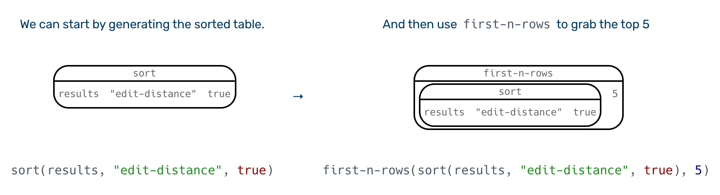
Composing with Circles of Evaluation
Circles of Evaluation let us see the structure.
What do you Notice? What do you Wonder?

Slide 15
Composing with Circles of Evaluation
To convert a Circle of Evaluation into code, we start at the outside and work our way in. After each function, we write a pair of parentheses, and then convert each argument inside the Circle.
Complete Composing with Circles of Evaluation.
Notes:
There are multiple solutions to the bottom half of this page! Press your students to come up with both.
Both Contracts for Strings and Images and Contracts for Tables and Rows include worksheets to help students practice composing functions using the Circles of Evaluation.
For a more project-based approach that's suitable for a CS or Math class, teach Transforming and Composing Images and have students tackle Project: Create Your Own Logo or Project: Make a Flag.

Slide 16
Composing with Circles of Evaluation
Why might it be useful to separate the thinking and coding steps? Why not just do them at the same time, all the time?
Notes:
Why might it be useful to separate the thinking and coding steps? Why not just do them at the same time, all the time?

Slide 17
Data Visualization
There were only a few suggestions with an edit-distance of 1, but more with distances of 2, 3, and 4. As edit-distance increases, the number of suggestions increases, too.
But does it increase by the same amount each time?
How could you communicate this growth to someone else, without making them scan the whole table?
Notes:
But does it increase by the same amount each time?
No! It grows by larger amounts for each edit-distance!
It's almost exponentially larger
How could you communicate this growth to someone else, without making them scan the whole table?
You could count the number of suggestions for each edit-distance
You could make a chart

Slide 18
Data Visualization
Complete the first section of Data Visualization for Tables

Slide 19
Data Visualization
The count function produces a frequency table, showing how often a suggested word has an edit-distance of 1, 2, 3, and so on.
How is our bar chart connected to our frequency table?
Could you make a bar chart of the first 200 suggestions in your results table?
Notes:
How is our bar chart connected to our frequency table?
The bars are the same height as the numbers in that table
Could you make a bar chart of the first 200 suggestions in your results table?
Yes! We could diagram it using the Circle of Evaluation, with one circle for trimming and another for the bar chart

Slide 20
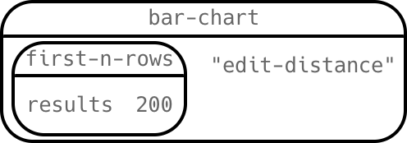
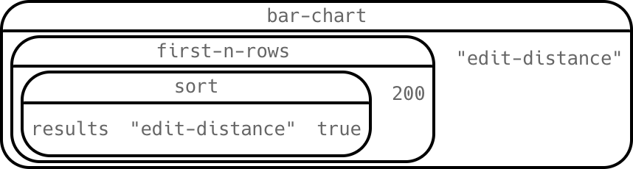
Data Visualization
Here's the Circle of Evaluation for our bar chart, showing only the first 200 suggestions:
What will this Circle of Evaluation do?

Slide 21

Data Visualization
A cell phone or spell-checker doesn't show you rows and columns - it just shows you the words! Once a spell checker gives us a table full of words and edit-distances....how do we get the words out?
Complete Data Visualization for Tables
Notes:
This lesson is not intended to teacher students how to read or interpret data visualizations! If you're blending this material into a Data Science or Math class where various visualizations are part of your learning goals, we highly recommend exploring our Data Science course.

Slide 22
Data Visualization
Row accessors allow us to extract data from specific cells of our table by specifying the row number and column title.
What row number do we use to extract data from the first row of our table?
What code did you write to extract the 75th suggested word from the table?
What was the 75th suggested word?
Notes:
What row number do we use to extract data from the first row of our table?
0
What code did you write to extract the 75th suggested word from the table?
row-n(results, 74)["word"]
What was the 75th suggested word?
wield

Slide 23
Data Visualization
Why would a spell checking app need to use Row Accessor functions?
Notes:
Why would a spell checking app need to use Row Accessor functions?
Because we want to suggest a word, not a whole row of a table!
And we might want to take the edit-number into consideration when we make our suggestion.

Slide 24
Programming with Spelling Suggestions
Notes:
This is the pyret version of this lesson. Make sure you are using the right software tool (WeScheme, Pyret, CODAP, etc...)
To learn more about how to use PearDeck, and how to view the embedded links on these slides without going into present mode visit https://help.peardeck.com/en

Slide 25

Introducing Contracts
Make sure you've got the Spell Checker Starter File open, and your Definitions Area includes results = alt-words("plation", WORDS-L, 4).
Our spell-checker gives us lots of data to play with, in the form of tables of suggested words and their edit distances. We know how to save that data using variable definitions, so that we can refer back to it without having to recalculate the whole table.
Can we do anything interesting with that data?

Slide 26

Introducing Contracts
A spell-checker doesn't give us a table of 500 suggestions. Our cell phones don't tell us the edit distance for the suggestions they make. But just because it doesn't show us the edit distance doesn't mean it's not used! Your cell phone and spell checker uses the edit distance to help pick out the most-likely words to suggestion.
We want to take the output of alt-words and do something to it, just as spell checkers and cell phones do.

Slide 27
Introducing Contracts
Turn to Sorting and Trimming Tables and complete the first section: Sorting Results.

Slide 28
Introducing Contracts
What did these sort expressions do?
What does it mean that the Range of sort is Table?
Type results and hit "Enter". Did sorting our animals change the value of the table?
Notes:
What did these sort expressions do?
They took in the results table, the edit-distance column, and true or false... producing a new table, sorted alphabetically (ascending for true and descending for false)
What does it mean that the Range of sort is Table?
The function produces a new table.
Type results and hit "Enter". Did sorting our animals change the value of the table?
No. It made a new one.

Slide 29
Introducing Contracts
Let's review what we've learned about Contracts. Every Contract has three parts:
Name -- the name of the function, which we type in whenever we want to use it
Domain -- the type(s) of data we give to the function
Range -- the type of data the function produces
📌 Contracts are the instruction manual for functions.

Slide 30
Introducing Contracts
Let's explore the Contract for another function that works with Tables: first-n-rows
Complete the second section of Sorting and Trimming Tables: Trimming Results.

Slide 31
Introducing Contracts
There were only a few suggestions with an edit-distance of 1, but more with distances of 2, 3, and 4. As edit-distance increases, the number of suggestions increases, too.
But does it increase by the same amount each time?
How could you communicate this growth to someone else, without making them scan the whole table?
Notes:
But does it increase by the same amount each time?
No! It grows by larger amounts for each edit-distance!
It's almost exponentially larger
How could you communicate this growth to someone else, without making them scan the whole table?
You could count the number of suggestions for each edit-distance
You could make a chart

Slide 32
Introducing Contracts
Complete the first section of Data Visualization for Tables

Slide 33
Introducing Contracts
The count function produces a frequency table, showing how often a suggested word has an edit-distance of 1, 2, 3, and so on.
How is our bar chart connected to our frequency table?
Notes:
How is our bar chart connected to our frequency table?
The bars are the same height as the numbers in that table

Slide 34

Introducing Contracts
A cell phone or spell-checker doesn't show you rows and columns - it just shows you the words! Once a spell checker gives us a table full of words and edit-distances....how do we get the words out?
Complete Data Visualization for Tables
Notes:
This lesson is not intended to teacher students how to read or interpret data visualizations! If you're blending this material into a Data Science or Math class where various visualizations are part of your learning goals, we highly recommend exploring our Data Science course.

Slide 35
Introducing Contracts
Row accessors allow us to extract data from specific cells of our table by specifying the row number and column title.
What row number do we use to extract data from the first row of our table?
What code did you write to extract the 75th suggested word from the table?
What was the 75th suggested word?
Notes:
What row number do we use to extract data from the first row of our table?
0
What code did you write to extract the 75th suggested word from the table?
row-n(results, 74)["word"]
What was the 75th suggested word?
wield

Slide 36
Introducing Contracts
first-n-rows and last-n-rows have exactly the same Domain and Range, but do different things. So do circle and triangle. How is it possible to have the same Domain and Range, and behave so differently?
Why did sort need more arguments in its Domain than either of the other two?
Notes:
first-n-rows and last-n-rows have exactly the same Domain and Range, but do different things. So do circle and triangle. How is it possible to have the same Domain and Range, and behave so differently?
What a function needs is not the same as what it does.
Why did sort need more arguments in its Domain than either of the other two?
It needed to know more things!

Slide 37
Introducing Contracts
Why would a spell checking app need to use Row Accessor functions?
Notes:
Why would a spell checking app need to use Row Accessor functions?
Because we want to suggest a word, not a whole row of a table!
And we might want to take the edit-number into consideration when we make our suggestion.

Slide 38
Composing with Circles of Evaluation
Your cell phone doesn't show you every possible suggestion:
It only shows you the top 3-5
It usually sorts them by edit-distance (smaller mistakes first)
How do you think the functions you've learned could be used to do the same thing? Discuss with the other students at your table or nearby.
Notes:
Have students share their ideas

Slide 39


Composing with Circles of Evaluation
What if we wanted to sort and trim our tables?
By looking at the Range, we know that sort produces a Table
By looking at the Domain, we know that first-n-rows consumes a Table
But how could the sort and first-n-rows functions work together?

Slide 40
Composing with Circles of Evaluation
One way to organize our thoughts is to diagram what we want to do. Circles of Evaluation help us think about what we want to do, without worrying about syntax like quotation marks, parentheses, etc. They let us use all our brains for thinking, before we use them for coding.
The rules are simple:
(1) Every Circle of Evaluation must have one -- and only one! -- function, written at the top.
(2) The arguments of the function are written left-to-right, in the middle of the Circle.
Values like Numbers, String, and Booleans are still written by themselves. It’s only when we want to use a function that we need to draw a nested Circle.
(3) Circles can contain other Circles!

Slide 41
Composing with Circles of Evaluation
Suppose we want to see the top 5 results of alt-words, sorted by increasing edit-distance.
Turn to Composing with Circles of Evaluation and complete the Notice and Wonder section.

Slide 42
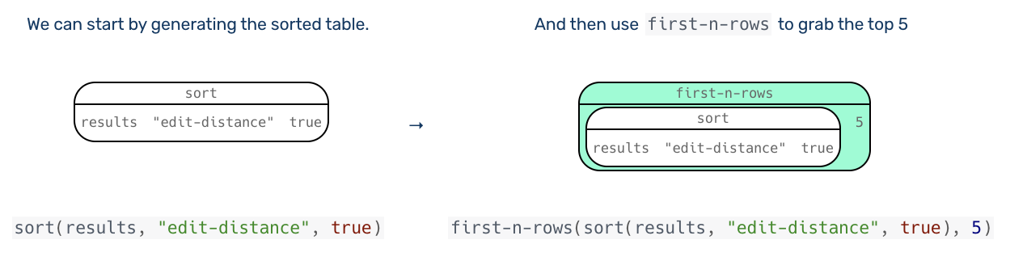
Composing with Circles of Evaluation
Circles of Evaluation let us see the structure.
What do you Notice? What do you Wonder?

Slide 43
Composing with Circles of Evaluation
To convert a Circle of Evaluation into code, we start at the outside and work our way in. After each function, we write a pair of parentheses, and then convert each argument inside the Circle.
Complete Composing with Circles of Evaluation.

Slide 44
Composing with Circles of Evaluation
Pyret knows about more than just Numbers, String, Booleans, and Tables! It can also make Images.
Have some fun with User Interface for our Spelling Checker.
Notes:
Supporting Diverse Learners
Image exploration is a low threshold / high-ceiling activity that should be engaging to all students.
Some students may find ALL of the contracts, but most will not!
When the first student in your class has successfully used the text function, give directions about which functions to prioritize with the remaining time.
For a deeper dive into Image and Table contracts, have students work on pages from Contracts for Strings and Images and Contracts for Tables and Rows.
Do not try to keep your students in lock-step. What is important here is for everyone to have the opportunity to explore.
Students do not need to find all of the contracts on this page in order to complete the lesson or the following pages. If you have to prioritize, make sure students complete the first five (up to and include text).
Both Contracts for Strings and Images and Contracts for Tables and Rows include worksheets to help students practice composing functions using the Circles of Evaluation.
For a more project-based approach that's suitable for a CS or Math class, teach Transforming and Composing Images and have students tackle Project: Create Your Own Logo or Project: Make a Flag.

Slide 45
Composing with Circles of Evaluation
Why might it be useful to separate the thinking and coding steps? Why not just do them at the same time, all the time?
Notes:
Why might it be useful to separate the thinking and coding steps? Why not just do them at the same time, all the time?

